Slide 1
James Webb Space Telescope
2022311224 이진진

Slide 2
01
02
03
04
Instruments
Observing mode
Data analysis
Detector

Slide 3
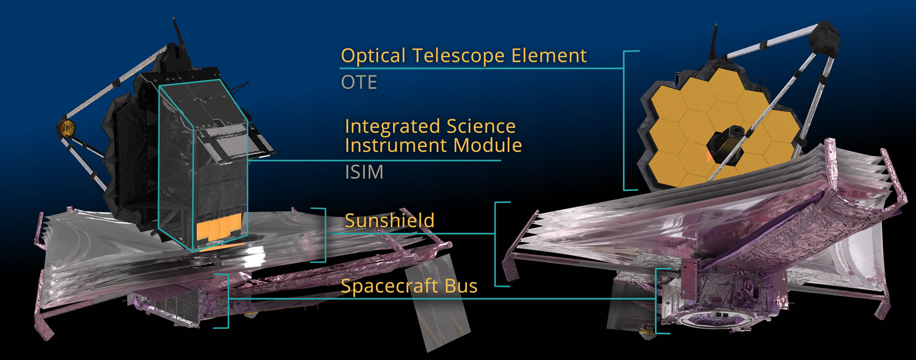
01
Instrument

Slide 4
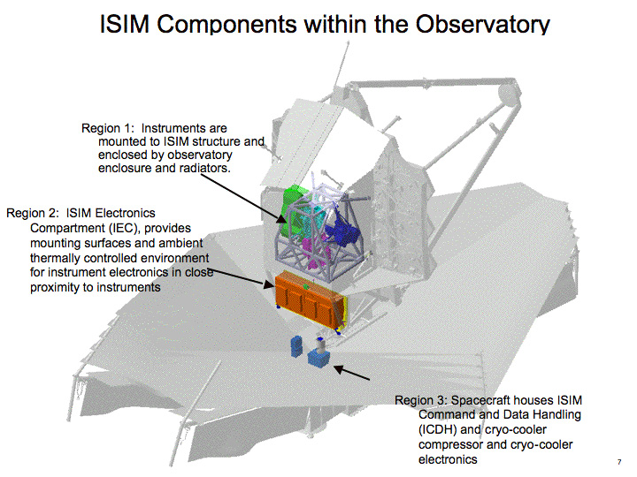
01
Instrument - ISIM
1. Near-Infrared Camera (NIRCam)
2. Near-Infrared Spectrograph (NIRSpec)
→ 0.6 – 5 μm
3. Mid-infrared Instrument (MIRI)
→ 5 – 28.3 μm
4. Fine-Guidance Sensor / Near Infrared imager
and Slitless Spectrograph (FGS-NIRISS)
→ 0.8 – 5 μm

Slide 5
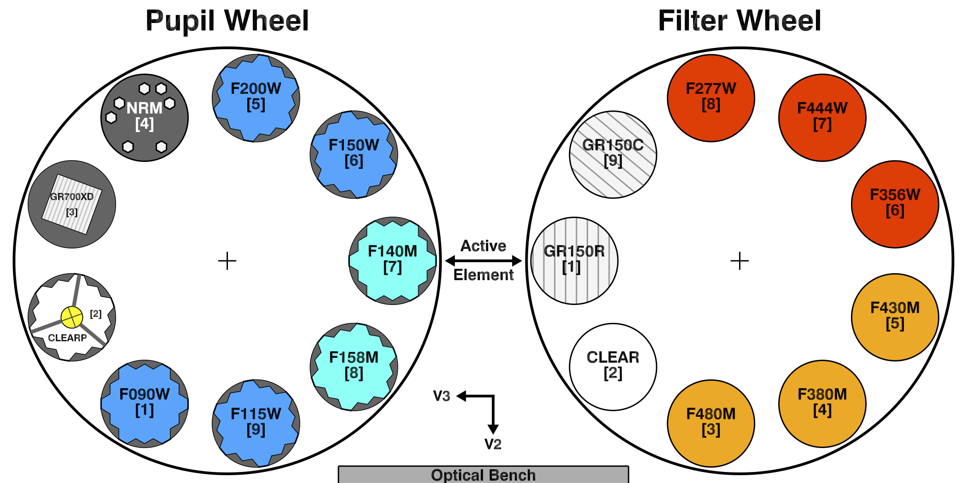
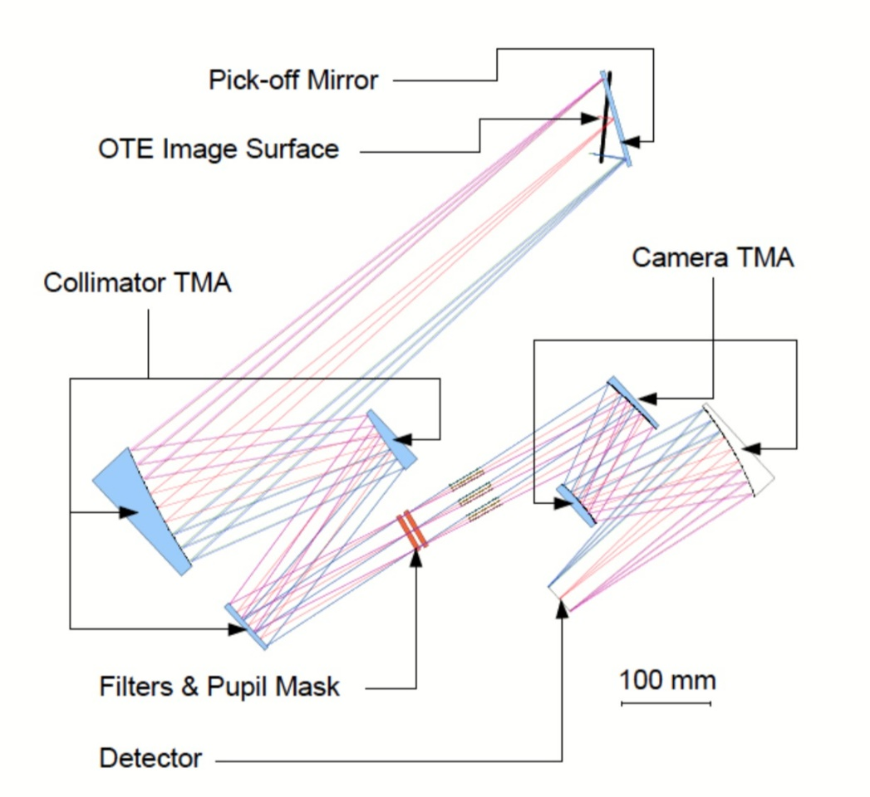
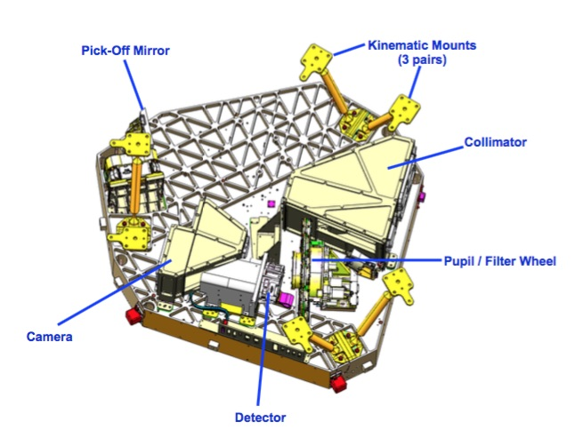
01
Near Infrared imager and Slitless Spectrograph (NIRISS)

Slide 6
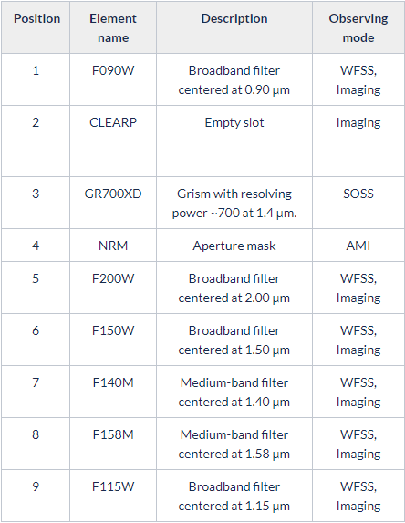
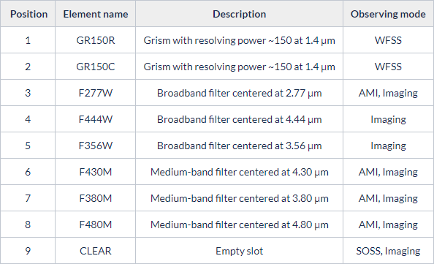
01
Near Infrared imager and Slitless Spectrograph (NIRISS)

Slide 7
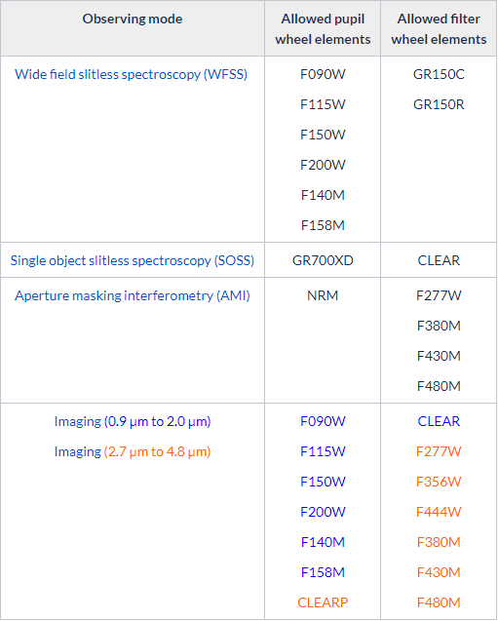
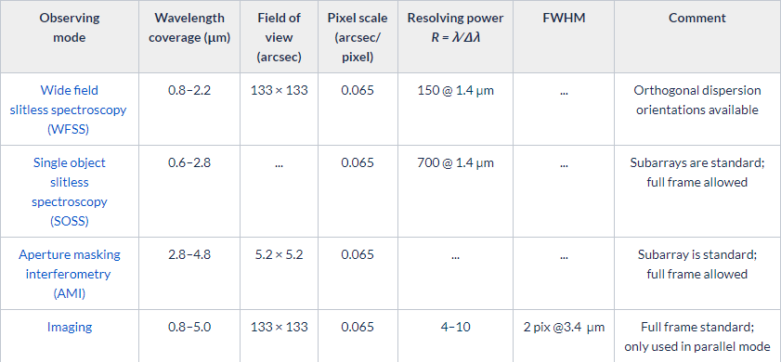
02
Observing mode
1. Wide-field slitless spectroscopy (WFSS) – 0.8 ~ 2.2 μm
2. Single object slitless spectroscopy (SOSS) – 0.6 ~ 2.8 μm
3. Aperture masking interferometry (AMI) – 2.8 ~ 4.8 μm
4. Imaging – 0.8 ~ 5.0 μm

Slide 8
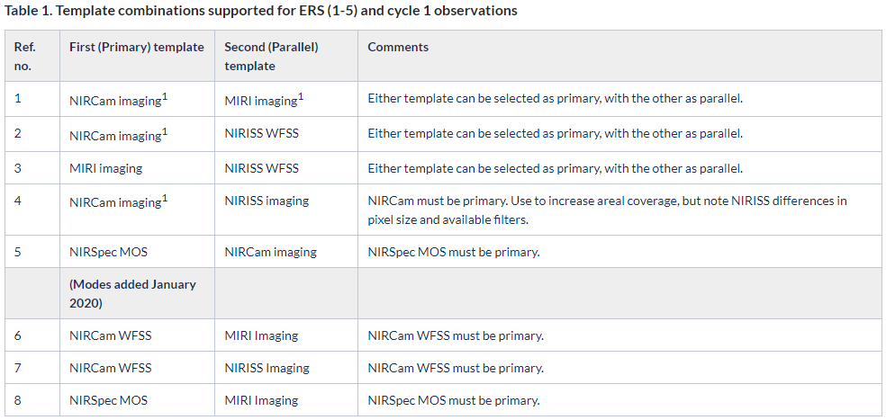
02
Observing mode – Imaging mode
ㆍEnables standard multi-wavelength imaging
ㆍ12 filters (0.8-5.0 μm)
ㆍ2.2’ x 2.2’ field of view
ㆍ0.065” / pixel image scale
ㆍfundamental component of the WFSS

Slide 9
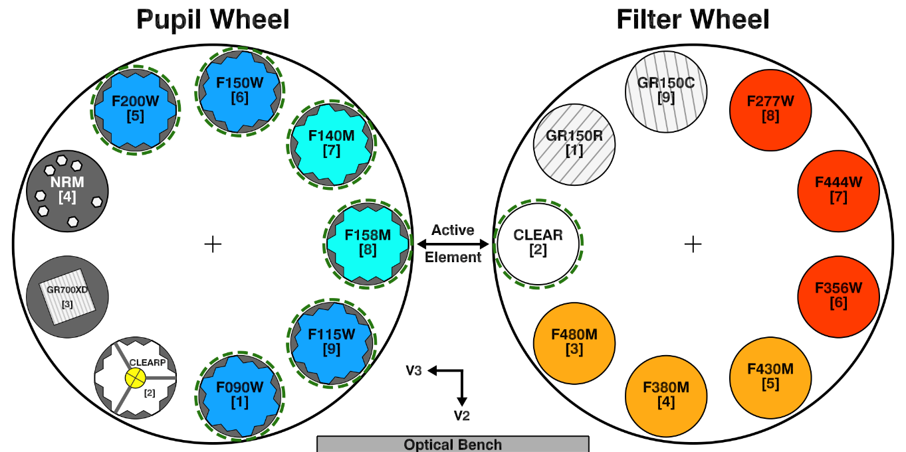
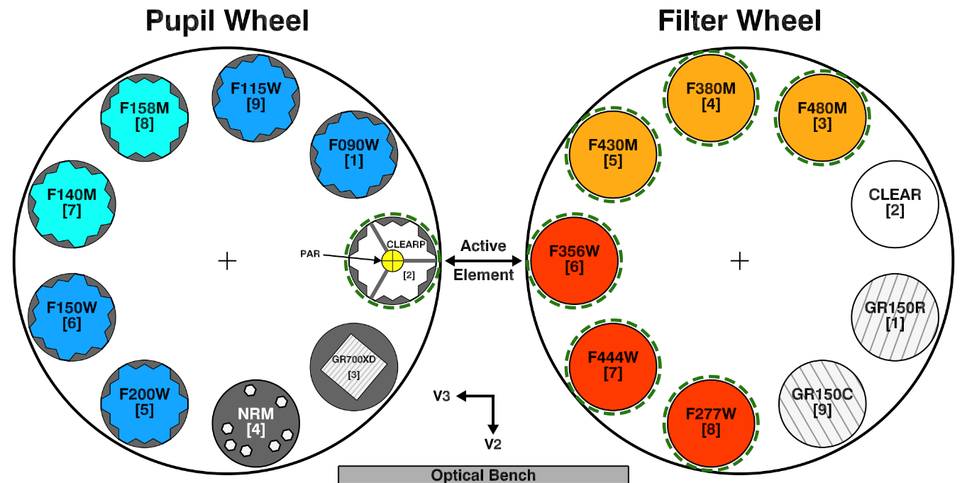
03
Data analysis

Slide 10
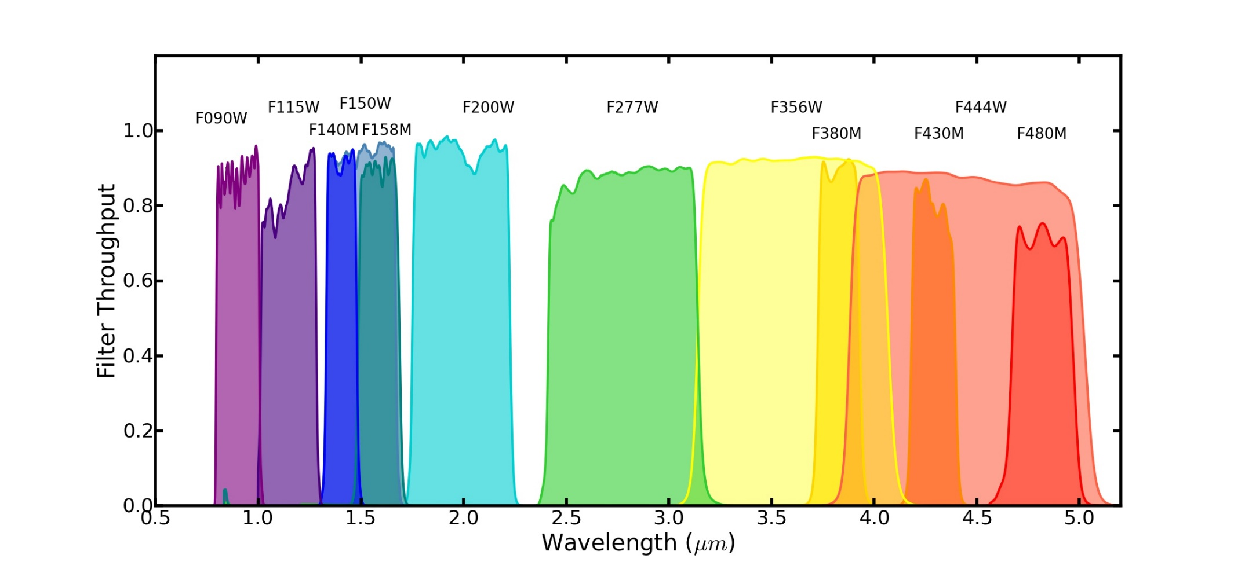
03
Data analysis

Slide 11
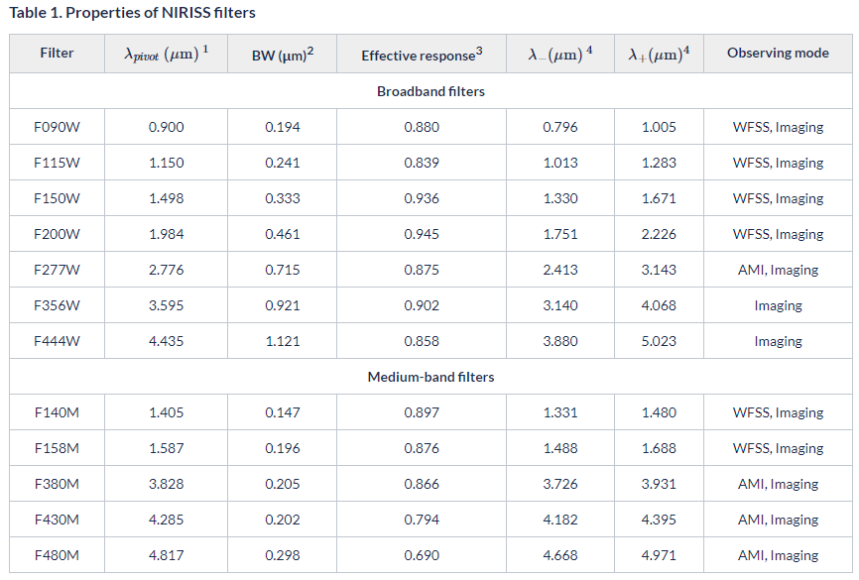
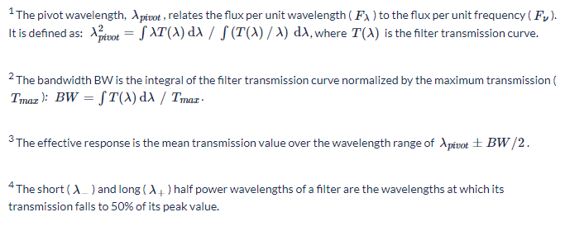
03
Data analysis

Slide 12
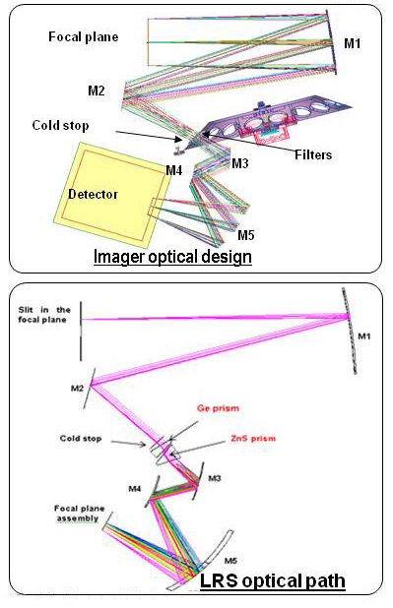
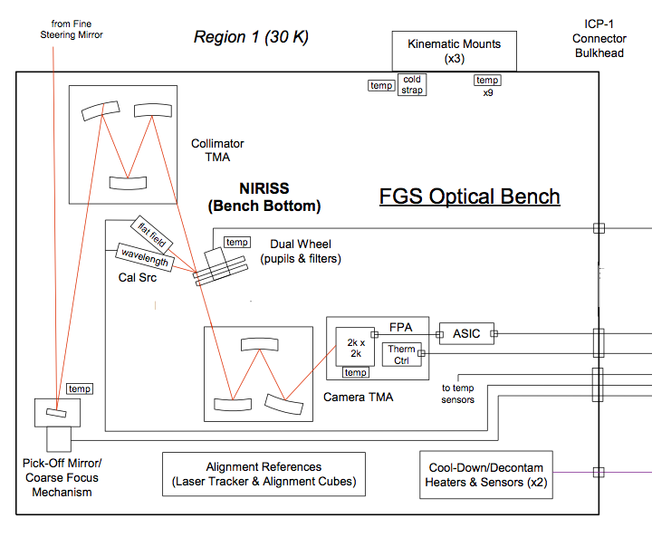
03
Data analysis

Slide 13
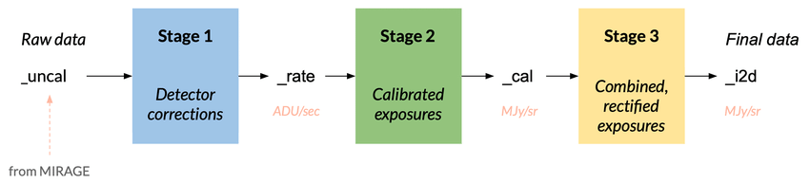
03
Data analysis

Slide 14
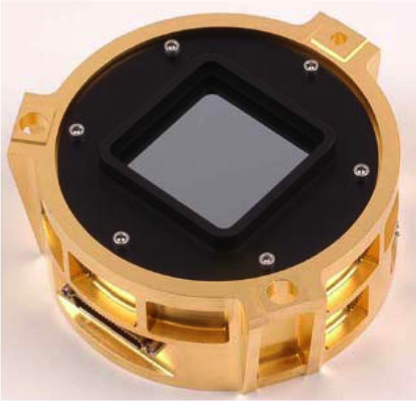
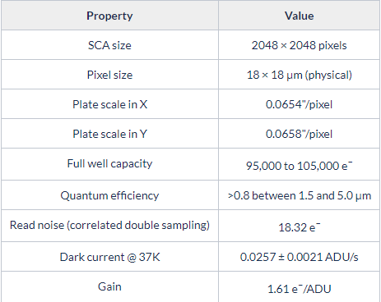
04
Detector
Hawaii-2RG

Slide 15
THANK YOU
FOR LISTENING

